Slide 1
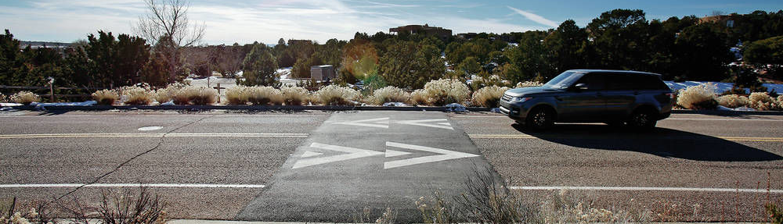
Speed Humps

Slide 2
Overview
1

Slide 3
Overview
What are Speed Humps?
Formally known as speed reducers,:
Include some bullets
And another point

Slide 4
Photo/Map/ Diagram Slide
Add Content (What is shown?)
Add some bullet points
Add another bullet point

Slide 5
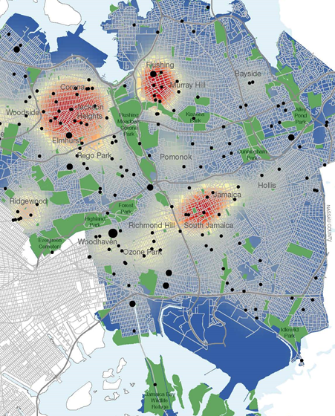
Safety in the Downtown Core
Map of Queens Crashes
Add some bullet points
Example Map/Image Slide with Notes
Keep your bullets short. Less is more in PPT presentations.

Slide 6
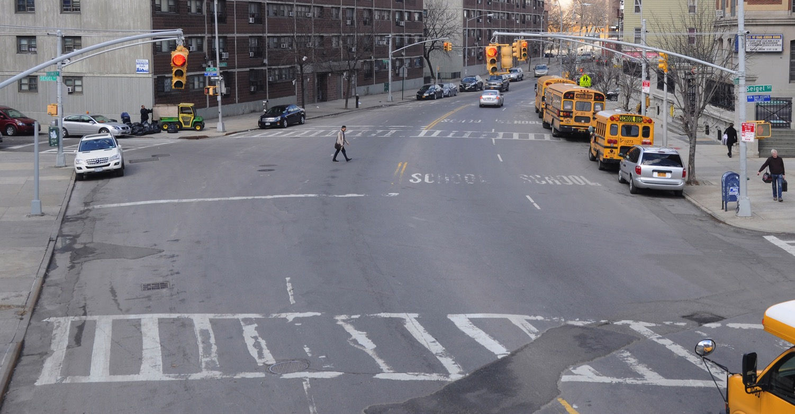
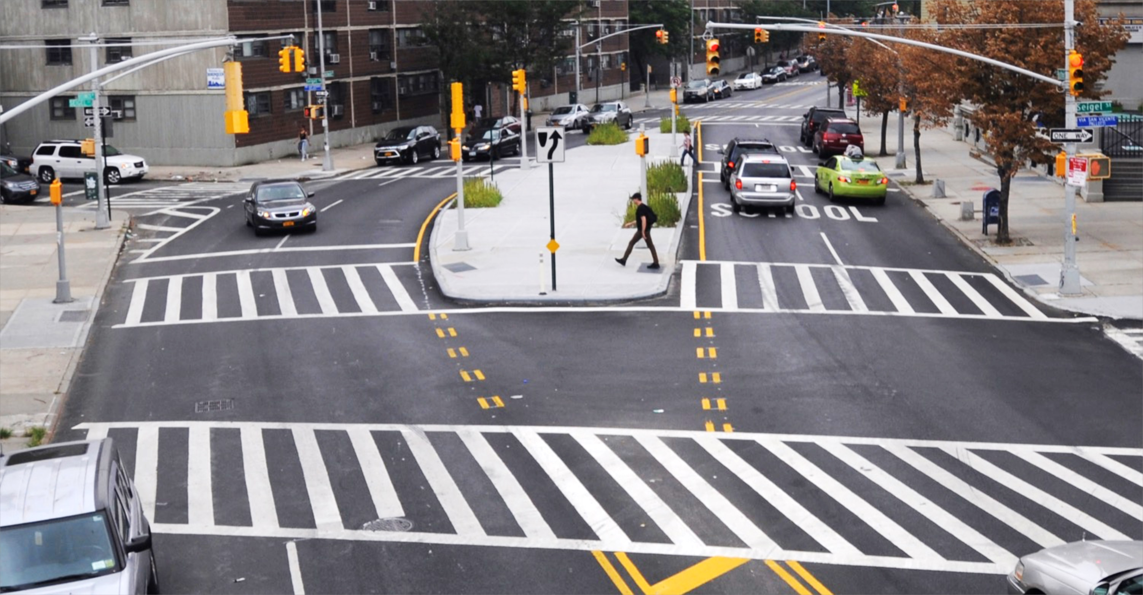
Before and After Photos
Before/After Photos
Maximize the size and fill the entire slide with image. Use a simple animation to “fade in” the After photo on top of the Before photo.
*Please make sure slide has a title, even if it’s not visible.*

Slide 7
Section Divider 1
1

Slide 8
Section Divider 2
2

Slide 9
Section Divider 3
3

Slide 10
Thank You!
Questions?

